Slide 1
Project Sunlight
May 10, 2021
www.suny.edu

Slide 2
Project Sunlight
What is it?
What does it mean?
Requirements
Exclusions
Questions
www.suny.edu

Slide 3
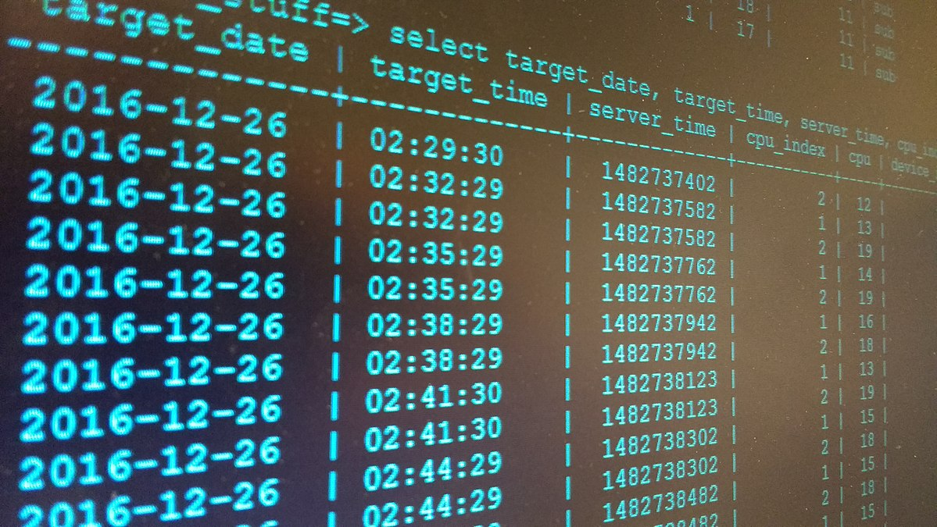
What is it?
An online database that provides the public with an opportunity to see the individuals and entities that are interacting with government decision-makers
www.suny.edu
This Photo by Unknown Author is licensed under CC BY-SA

Slide 4
What does it mean?
All covered interactions must be reported into the database (within 5 business days after occurrence)
In order for an interaction to be covered and reportable by Project Sunlight it must:
Be an appearance,
Between covered individuals, and
Concern one of the five subject areas covered by Project Sunlight
www.suny.edu

Slide 5
Appearance
An interaction that is an in-person meeting or a video conference between covered individuals, related to one of the five covered categories.
The location and formality of the interaction is irrelevant
It is irrelevant who initiates the interaction
There can be numerous appearances related to a single matter
www.suny.edu

Slide 6
Appearance
Emails
Phone Calls
Faxes
Letters
Inter
Gov’t
www.suny.edu

Slide 7
Covered Individuals
Government (SUNY) employees who have the power to exercise agency discretion or advise someone who has such discretion
Each organization should maintain a list of individuals that fit this definition
www.suny.edu

Slide 8
Subject Areas
Procurement over $25K
Rulemaking
Ratemaking
Regulatory Matters
Judicial Proceedings
www.suny.edu

Slide 9
Rulemaking
Adoption or Appeal of a Rule or Regulation
Outside entities advocating for an adoption or repeal of a new rule or regulation (lobbyists, e.g.)
Only applies to rules/regulations – not statutes or proposed bills
www.suny.edu

Slide 10
Ratemaking
Influencing the setting or application of rates
What rate will be charged
How the rate is applied to a specific group or individual
Does not include questions about the rate explicitly – unless it turns into advocacy
www.suny.edu

Slide 11
Regulatory Matters
Enforcement of Regulations and Laws
Influence how the regulation or law will be applied or interpreted
Inquiries and complaints are not reportable on their own
www.suny.edu

Slide 12
Judicial and Quasi-Judicial Proceedings
Items Before a Neutral Arbiter
The State (SUNY) must be a party of the proceedings
Discipline matters, contractual grievances, challenges to performance evaluations are excluded
www.suny.edu

Slide 13
Procurement
Types
Real property
Goods (commodities)
Services (includes leases)
www.suny.edu

Slide 14
Procurement
Amount
Total Contract Value (TCV) is reasonably expected to be $25,000 or more.*
TCV = Term (Years) x Cost Per Year
* NYS State Funds (all or partial)
www.suny.edu

Slide 15
Procurement
When
Anytime before a procurement’s Restricted Period, which is the date of the earliest notice of intent to solicit offers/bids through the date of the final award (if applicable, includes approval by Office s of the Attorney General and State Comptroller).
www.suny.edu

Slide 16
Procurement
Gym
Restaurant
Bar
Video Conference*
In-person Conference*
Store
Child’s School Event
Almost Anywhere!
Where
www.suny.edu

Slide 17
Procurement
Who*
Presidents;
Vice Presidents for Administration;
Vice Presidents for Student Affairs;
Vice Presidents for Research;
Vice Presidents for Academic Affairs/Provosts
Athletics Directors;
Deans.
Directors of Procurement;
* Not all inclusive.
www.suny.edu

Slide 18
Exclusions
Ministerial appearances or appearances requesting information, as they are not “representative” appearances
Telephone conversations
Written communications such as letters, faxes, emails, or the filing of paper applications
Appearances regarding legislation or the budget.
www.suny.edu

Slide 19
Exclusions
Appearances related to individuals or matters that are treated by a state entity as confidential pursuant to federal or state statute, rule, or regulation
Appearances that if disclosed could endanger the life or safety of any person
Participation in meetings which are open to the public, such as conferences or meetings subject to the Open Meetings Law or where a record of the meeting is otherwise publicly available
www.suny.edu

Slide 20
Exclusions
Any intergovernmental interactions, such as appearances by other state and local entities, as well as tribal governments and federal government representatives, and appearances by elected or appointed officials, executive or legislative employees, or judges or employees of the judiciary
www.suny.edu

Slide 21
Exclusions – Specific to SUNY
Appearances related to proposed, emergency, or final rulemaking relating to the formula for state financial operating assistance to community colleges, which involves completing a ministerial calculation of aid per estimated full time equivalent student.
Employee and student disciplinary hearings.
Appearances by vendors before health care practitioners across the SUNY system.
Appearances by students regarding changes in tuition, fees, and charged.
Interactions at widely-attended vendor conferences.
www.suny.edu

Slide 22
Reporting Logistics
Appearances should be timely entered into the database within five business days after they occur
Each appearance need only be entered once. If multiple covered individuals from state entities attend a meeting, only one entry need be made
State entities are responsible for internally assigning those staff members who will be responsible for reporting the appearances (as well as an individual to enter the data)
All inquiries regarding the Project Sunlight database should be directed to help@projectsunlight.ny.gov and/or a state entity’s Project Sunlight liaison
www.suny.edu

Slide 23
Helpful Links/Resources
Main Site: https://projectsunlight.ny.gov/
Policy: https://projectsunlight.ny.gov/Policy.pdf
FAQ’s: https://projectsunlight.ny.gov/FAQ.pdf
Contact:
Christian Mullin, SUNY Compliance Officer and Director of Risk Management
Christian.Mullin@suny.edu
518-320-1132
help@projectsunlight.ny.gov
www.suny.edu

Slide 24
Thank You
www.suny.edu

